Slide 1
Lecture 10. Domain modeling with
Restaurant System example
Object Oriented Modeling Technology
面向对象建模技术
Professor: Yushan Sun
Spring Term 2019

Slide 2
内容提要:
Concept of Business Modeling
Concept of Domain Modeling
Domain Modeling Examples
Domain Modeling on the Restaurant System (Mark Priestley: 4.1, 4.6, 4.7)
In Class Discussion

Slide 3
Concept of Business Modeling

Slide 4
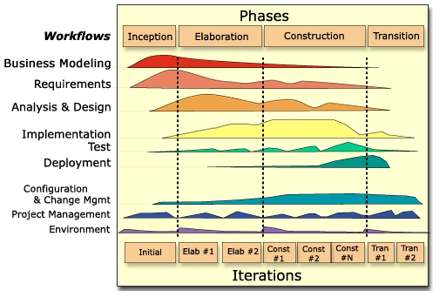
Concept of Business Modeling
Time
Development
Activities
an overview of the unified process

Slide 5
Concept of Business Modeling
Purpose of Business Modeling
理解组织的结构与关系 To understand the structure and dynamics of the organization in which a system is to be deployed
理解目标组织的当前问题，确认可能的改善 To understand current problems in the target organization and identify areas for potential improvement
  例如，需要改善政府审批流程

Slide 6
Concept of Business Modeling
确保客户，最终用户和开发者对目标组织有共同的理解 To ensure customers, end users, and developers have a common understanding of the target organization
导出支持目标组织的系统需求 To derive the system requirements to support the target organization.
在IBM的RUP模型中，业务建模是第一项工作 In the RUP, Business modeling is the first discipline that should be addressed and is key to acquiring key artifacts

Slide 7
Concept of Business Modeling
业务建模帮助理解应用程序运行环境，和本应用对企业业务的影响. Business Modeling is Very helpful to understand the environment in which the application will function and how this application will impact the business it is to support
业务领域模型的某些元素将直接关系到软件领域Some items in the business domain model will relate directly to the software domain.

Slide 8
业务建模的几个场景
Concept of Business Modeling
Scenario 1：build an organization Chart (创建组织结构图)
  Build a simple org chart of business and its processes to get a good understanding of the application you are building.
    Where does the application fit?
    To which organizations might it impact?
    Emphasis is on ‘the organization.’

Slide 9
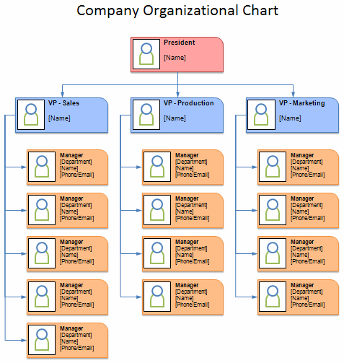
董事长
副董事长
副董事长

Slide 10
Concept of Business Modeling
Scenario 2：build a domain model(领域建模)
  Build a model of that information (banking, order management) that will be present at the business level.
  Domain Modeling is a typically part of the software project and is performed during
    inception and
    elaboration phases
  started in inception and refined in elaboration.
Return
业务建模的其它部分省略

Slide 11
Concept of Domain Modeling

Slide 12
What is a domain model?
Concept of Domain Modeling
捕捉业务(商业)环境最重要的对象 A domain model captures the most important types of objects in the context of the business.
代表存在的“实物” 或业务环境中出现的事件 The domain model represents the ‘things’ that exist or events that transpire (显露) in the business environment.”
– I. Jacobsen

Slide 13
为什么要创建领域模型？
Why do a domain model?
Concept of Domain Modeling
A domain model:
给出概念框架。gives a conceptual framework of the things in the problem space
协助思维。helps you think: focus on semantics (语义)
提供词典。provides a glossary of terms
静态视图：显示时间不变业务规则。is a static view: it allows us convey time invariant business rules

Slide 14
Concept of Domain Modeling
A Simple Domain Model example
Person
employee
employer
Company
-firstName : String
-lastName : String
-ssn: String
-position: String
1..*
0..1
-name
1
<<Rule>>
If a person is not employed
by a company, then he or she
doesn’t have a car.
owner
*
Car
-make: String;
-year: int
-model: String
-carId: String
公司职员配车系统

Slide 15
Concept of Domain Modeling
领域建模的知识从哪里来？
Sources of Domain (Class) Knowledge:
  high-level problem statements;
  requirements;
  expert knowledge of the problem space;
  anything that describes the problem space and the desires and needs of the stakeholders.

Slide 16
领域模型的组成特征 Features of a domain model
Concept of Domain Modeling
Domain classes(领域类) – each domain class denotes a type of object.
Attributes(属性) – the description of a named slot of a specified type in a domain class
Associations(关联) – a relationship between two (or more) domain classes that describes links between their object instances.
Additional rules(额外规则) – complex rules that cannot be shown with symbology can be shown with attached notes.

Slide 17
领域模型可以代表什么？
What a Domain class can present?
Concept of Domain Modeling
每个领域类代表一种类型的对象。
Each domain class denotes a type of object. It is a descriptor for a set of things that share common features. Classes can represent.

Slide 18
怎样创建领域模型？
How to create a domain model?
Concept of Domain Modeling
Perform the following in very short iterations:
建立领域类列表。Make a list of candidate domain classes.
使用UML画出类图。Draw these classes in a UML class diagram.
针对每个类添加一些描述。If possible, add brief descriptions for the classes.
确定各个类之间是否存在必要的关联。Identify any associations that are necessary.

Slide 19
Concept of Domain Modeling
有些类是没有必要的，可能仅仅是某些类的属性。Decide if some domain classes are really just attributes (e.g., color)
确认关联的角色名与重数。Where helpful, identify role names and multiplicity for associations.
添加一些文字规则，解释在UML图中不方便表达的事项。Add any additional static rules as UML notes that cannot be conveyed with UML symbols.
将领域类分类，组织成包。Group domain classes by category into packages.

Slide 20
怎样确定领域类？
How to identify domain classes?
Concept of Domain Modeling
领域描述中的名词可能成为类名。Nouns in textual descriptions of a domain can become names of the domain classes.
所以，为了创建领域类，我们应该在领域商业描述中查找名词。In order to create domain classes, our task is to identify nouns in the domain business description.

Slide 21
创建领域模型的9项指南
Top 9 Domain Modeling Guidelines
Concept of Domain Modeling
Focus on real-world domain Objects
专注于问题领域的现实世界对象(模拟现实世界)
  When creating a domain model, be sure to focus on real-world objects within the problem domain.
  Try to organize your software architecture around what the real world looks like.

Slide 22
Concept of Domain Modeling
2. Use generalization and aggregation
relationships to show how the objects
relate to each other (使用泛化、聚合)
  The class relationships
      generalization
      aggregation, and
      associations
  are the most important relationships in
  your domain model.

Slide 23
Concept of Domain Modeling
3. Limit your initial domain modeling efforts
to a couple of hours (不要花太多的时间在创建领域模型上)
  不求完美。You’re not going to make the domain model perfect the first time you create it, so do it quickly and expect to fix it as you proceed.
  留待分析、设计阶段再添加。You can make necessary adjustments to your analysis-level class model in response to discoveries made during robustness analysis and throughout the project.

Slide 24
Concept of Domain Modeling
4. Organize your classes around key abstractions in the problem domain (关键抽象)
It’s generally good practice to organize your classes around key abstractions in the problem domain.
  领域模型是基础类图。the domain model is the first class diagram that becomes the foundation of your software architecture;
  针对需求改变具有弹性。organizing the architecture around real-world abstractions makes the model more resilient in the face of changing requirements

Slide 25
Concept of Domain Modeling
5. Don’t mistake your domain model for a data model (领域模型 ≠ 数据模型)
  类较小，数据库表格较大。Classes are small and database tables are bigger. A table in a relational database often relates a number of things;
  (此阶段) 通常设计较小的类。Usually you are expected to design small classes: containing relatively small packets of data and behavior;

Slide 26
Concept of Domain Modeling
6. Don’t confuse an object with a database table (对象≠ 数据库表格)
  对象代表某种东西的实例。An object represents a single instance of something, e.g., an instance of class Book represents a single book
  数据库表格代表一些东西的集合。A database table represents a collection of things, a table Book may contain a lot of books

Slide 27
Concept of Domain Modeling
7. Use the domain model as a project glossary (将领域模型作为项目词典)
  确保项目前后名词一致。The domain model should serve as a project glossary that helps to ensure consistent usage of terms when describing the problem space.
  Purpose: to disambiguate your model
    ambiguous names: shopping cart, shopping basket or shopping trolley

Slide 28
Concept of Domain Modeling
8. Don’t expect your final class diagrams to precisely match your domain model, but there should be some resemblance between them (不要指望最终的设计类图与领域模型完全一致；却有一些相像)
  The domain model is deliberately kept quite simple;
  Although a lot of other classes will be added in the design process, it should still be possible to trace most classes back to their equivalent domain class

Slide 29
Concept of Domain Modeling
9. Don’t put GUI classes and helper classes on your domain model (不要在领域模型图中包含GUI类与帮助类)
  The domain model should focus purely on the problem domain.
  Don’t include GUI classes in a domain model
  Don’t include performance optimization classes, helper classes, and so on in your domain model.

Slide 30
显示层
GUI
应用层
Gate
C
B
A
领域模型出现的类代表应用层的初步设计。
D
A11
A12
A13
D11
D12
A121
数据层
Return
JDBC

Slide 31
Domain Modeling Examples

Slide 32

Domain Modeling Examples
超市结账系统
【Example】: Consider a description of a super
market checkout system as follows:
  Customer arrives at a checkout with goods or services to purchase;
  Cashier starts a new sale;
  Cashier enters item identifier;
  System records the sale line item and presents the item description, price and running total.

Slide 33
名词列表：
  Customer
  Checkout
  goods
  services
  Cashier
  sale;
  item identifier;
  System
  sale line item
  item description,
  price and
  running total.

Slide 34
Domain Modeling Examples
Identify the names of the domain classes
Cashier
Sale
出纳员
货单
Goods
(一件)商品

Slide 35
Domain Modeling Examples
Add attributes to the domain classes
Cashier
Sale
-name: String
-id: String
-goods: Goods[ ]
-priceTotal: double
-clerk: Cashier
Goods
-identifier: String
-name: String
-price: double

Slide 36
Domain Modeling Examples
Decide relationships among classes
Sale
Cashier
1
*
-goods: Goods[ ]
-priceTotal: double
-clerk: Cashier
-name: String
-id: String
1
*
Goods
-identifier: String
-name: String
-price: double

Slide 37
Domain Modeling Examples
How about adding a Customer class?
Sale
Cashier
goods: Goods[ ]
priceTotal: double
cus: Customer
clerk: Cashier
1
*
-name: String
-id: String
*
Customer
1
-name: String
-ssn: String
-address: String
1
*
Goods
identifier: String
name: String
price: double
普通超市不记载客户

Slide 38
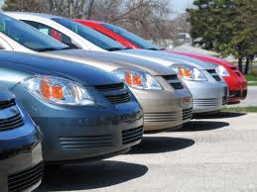
Domain Modeling Examples
租车系统
【Example】A Car Rental System.
  A car rental company wants to build a software system for management of its car rental business

Slide 39
Domain Modeling Examples
Requirement descriptions:
The system has a database to record all the rental details, including
    客户信息：customer’s name, ssn, sex, age,
    租期：rental period,
    每日租金：rent per day,
    总租金：total rent payable

Slide 40
客户网上申请。A customer applies for a car rental by submitting an application (form) via the car rental website; the application will contain the
  expected car model, made, year, etc car info
  the data will be sent to the database

Slide 41
Domain Modeling Examples
业务员检查网上申请、准备适合申请者的车。A company clerk will check the online applications constantly to prepare a suitable car for each customer
业务员接收还车。For a customer who wants to return his/her car, a clerk will check the
    car condition,
    period of the car rental,
    deposit amount,
    the total payment, and
    remaining payment

Slide 42
Domain Modeling Examples
Identify the names of the domain classes
Reservation
Rental
Clerk
预订
租单
业务员
Customer
Car
客户
车

Slide 43
Reservation
Rental
Clerk
cus: Customer
phone: String
email: String
carType: String
days: int
status: String
resvNum: int
renter: Customer
car: Car
numOfDays: int
deposit: double
paneltyFee: double
totalRent: double
totalFee: double
name: String
id: String
Customer
Car
name: String
sex: String
age: String
ssn: String
addr: String
creditLevel: int
type: String
licenseNum: long
made: String;
model: String
regNum: String
condition: String
rentPerDay: double
available: boolean
isRented: boolean

Slide 44
Reservation
Clerk
cus: Customer
phone: String
email: String
carType: String
days: int
status: String
resvNum: int
Rental
name: String
id: String
renter: Customer
car: Car
numOfDays: int
deposit: double
paneltyFee: double
totalRent: double
totalFee: double
1
0..1
0..1
0..1
1
1
0..1
Customer
1
name: String
sex: String
age: String
ssn: String
addr: String
creditLevel: int
type: String
licenseNum: long
Car
made: String;
model: String
regNum: String
condition: String
rentPerDay: double
available: boolean
isRented: boolean
Return

Slide 45
Domain Modeling for the
Restaurant System
饭店系统领域建模

Slide 46
4.1 INFORMAL REQUIREMENTS
需求: 自动饭店定单系统
Need to develop an automated booking system.
The system to be developed is intended to support the daily operations of a restaurant, including
  making reservations (就餐预定) and
  change reservation
  cancel reservation
  allocating tables (分派餐桌) to customers.
  change table

Slide 47
4.1 INFORMAL REQUIREMENTS
  订单显示: The new system should be able to display the information about the existing booking and the new booking
  订单更新: When
    new bookings are recorded,
    or changes made to existing bookings,
    or cancel a booking,
    the display should be immediately updated.

Slide 48
4.1 INFORMAL REQUIREMENTS
可用性: The system must make it easy to record significant events that take place when the restaurant is open, such as the arrival of a customer.
可操作性: users can directly manipulate data presented on the screen. E.g., to change
    the time of a booking, or
    the table it is allocated to
    etc

Slide 49
4.6 DOMAIN MODELLING
Now we create domain model on the Restaurant System.
  大系统，领域模型复杂 for large projects, a domain model is often very big and complex, but
  小系统，领域模型简单 for smaller systems, a simple domain model can usually be adequately described.

Slide 50
领域模型基于需求(用例描述)
In the restaurant booking system, the key business requirement is to record the fact that customers have made reservations, so we may start by identifying two classes to represent
  reservations and
  customers.

Slide 51
4.6 DOMAIN MODELLING
Customer
1
Makes
*
Reservation
name
phoneNumber
the person whose name and phone number are recorded by the system,
b) each customer may make many reservations.
Fig 4.8 Modeling customers and reservations

Slide 52
What other information must be recorded about reservations:
    The date and
    Time
    the number of people that can be seated at the table
Customer
makes
Reservation
1
*
name
phoneNumber
covers
date
time
桌子号码应该怎样表示呢？

Slide 53
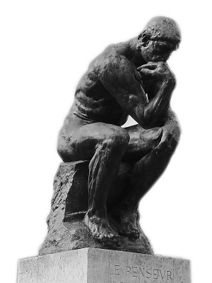
How to express a table (桌子) in a reservation? Two ways:
    to record the table number as another attribute of the reservation (桌子号作为属性)
    to model each table as an object, that is, to introduce a table class into the domain model (将餐桌表示为对象)
We decide to express a table as an object

Slide 54
4.6 DOMAIN MODELLING
Customer
1
makes
Reservation
*
name
phoneNumber
covers
date
time
Reservations for
the same table must
not overlap
*
一个订单
必须关联到
一张桌子
1
constraints
Table
num
places
Fig 4.9 Domain model including properties of
reservations

Slide 55
关于散客(没有预定的客人: walk-ins)
About walk-ins and reservation:
a) walk-ins shares some properties with
reservations: the basic data stored and
the link with a table, but
b) walk-ins is different from reservations: no
customer information is recorded about
walk-ins.
Need to define a general class, called Walkin, to capture the common properties of walk-ins, and reservation

Slide 56
Booking
1
Table
*
covers
date
time
num
places
Booking for the same table
must not be overlap
Makes
1
Walkin
Reservation
*
Customer
name
phoneNumber
暂时不记录客人信息-不和Customer相链接,将来再说
Fig 4.10 the domain model including walk-ins

Slide 57
walk-in类是否有必要?
Seemingly the walk-in class is redundant, because it does not have more properties than the booking class.
为了将来的扩展。If in a later time, we need to add other property of walk-ins to the model, this could be done easily with such a design

Slide 58
4.7 GLOSSARIES
为了后续开发使用的词汇表：
Booking: an assignment of a table to a party of diners for a meal.
Covers: the number of diners that a booking is made for.
Customer: the person who makes a reservation.
Diner: what a person will eat at the restaurant.
Places: the number of diners that can be seated at a particular table.
Reservation: an advance booking for a table at a particular time.
Walk-in: a booking that is not made in advance
Return

Slide 59
In-Class Discussion

Slide 60
In-Class Discussion
Task: Create a domain model for a large scale parking lot information system.
The system has only one functionality: to show the parking lot information on a screen (LED screen)
  To show the information about which slot is occupied
  To show the information about which slot is not occupied

Slide 61






Parking lot (停车场)
1st floor
Parking slot (停车位)
P1
P2
P3
P4
P5
P6
P7
P8
2nd floor
P1
P2
P3
P4
P5
P6
P7
P8
Parking slot with a car image means that it has been occupied.

Slide 62
domain model - parking lot information system
Display
ParkingLot
-slots: ParkingSlot[ ]
1
1..*
Sensor
1..*
1
ParkingSlot
number: int
-floor: int
-slotNum: String
-empty: boolean
Camera
PressSensor
-empty: boolean
-empty: boolean
Return

